Slide 1
Tutorial –
Detecting an Earthquake

Slide 2
P waves and S waves are released when an earthquake occurs, and are the waves we use to detect where earthquakes occur.
P waves travel the fastest so we detect them the earliest. S waves are slightly slower so we detect them after the P waves
The graph on the right shows the time it takes the P and the S waves to travel away from the epicentre of an earthquake.
By the way
The surface waves that do all the damage are the 3rd type of wave released by an earthquake and generally arrive well after the S and P waves.

Slide 3
Example 1: How long does it take a P-wave to travel 4,000 km?
Answer: 7 minutes

Slide 4
Example 2: How long does it take an S-wave to travel 4,000 km?
Answer: 12 min 40 sec

Slide 5
Example 3: How long does it take a P-wave to travel 8,000 km?
Answer: 11 min 20 sec

Slide 6
Example 4: How long does it take an S-wave to travel 8,000 km?
Answer: 20 min 40 sec

Slide 7
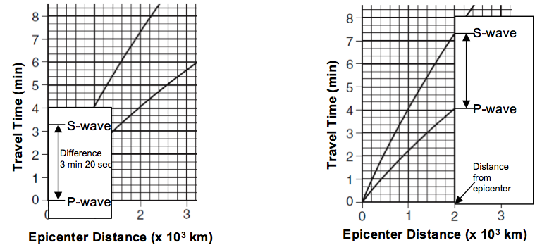
BUT – the real reason we measure S and P waves is they allow us to determine where the epicenter of the earthquake is located. Below is a description which allows you to calculate how far away an epicentre is.
  Find the difference in clock time between the P-wave and S-wave by subtracting the given times.
  Use the Y-axis (time travel) and use a piece of scrap paper to mark the time difference.
  Place the marked scrap paper between the P-wave and S-wave line on the graph. Slide the scrap paper along the graph to find the location that the interval is touching both P-wave and S-wave line.
  Determine the epicenter distance of this location using the X-axis.

Slide 8
Example: The first P-wave arrived at a seismic station at 10:00:00. The first S-wave arrived at the same seismic station at 10:08:40. How far is this seismic station from the epicenter?
10:08:40
- 10:00:00
00:08:40

Slide 9
Example: The first P-wave arrived at a seismic station at 10:00:00. The first S-wave arrived at the same seismic station at 10:08:40. How far is this seismic station from the epicenter?
Answer: 7,200 km

Slide 10
Example 2: The first P-wave arrived at a seismic station at 06:32:20. The first S-wave arrived at the same seismic station at 06:34:20. How far is this seismic station from the epicenter?
06:34:20
- 06:32:20
00:02:00

Slide 11
Example 2: The first P-wave arrived at a seismic station at 06:32:20. The first S-wave arrived at the same seismic station at 06:34:20. How far is this seismic station from the epicenter?
Answer: 1,200 km

